Slide 1
Academic Support 6-8
Back
to
School
Night
2020-21
Notes:
Change the title from Seminar to either period or subject you teach.

Slide 2
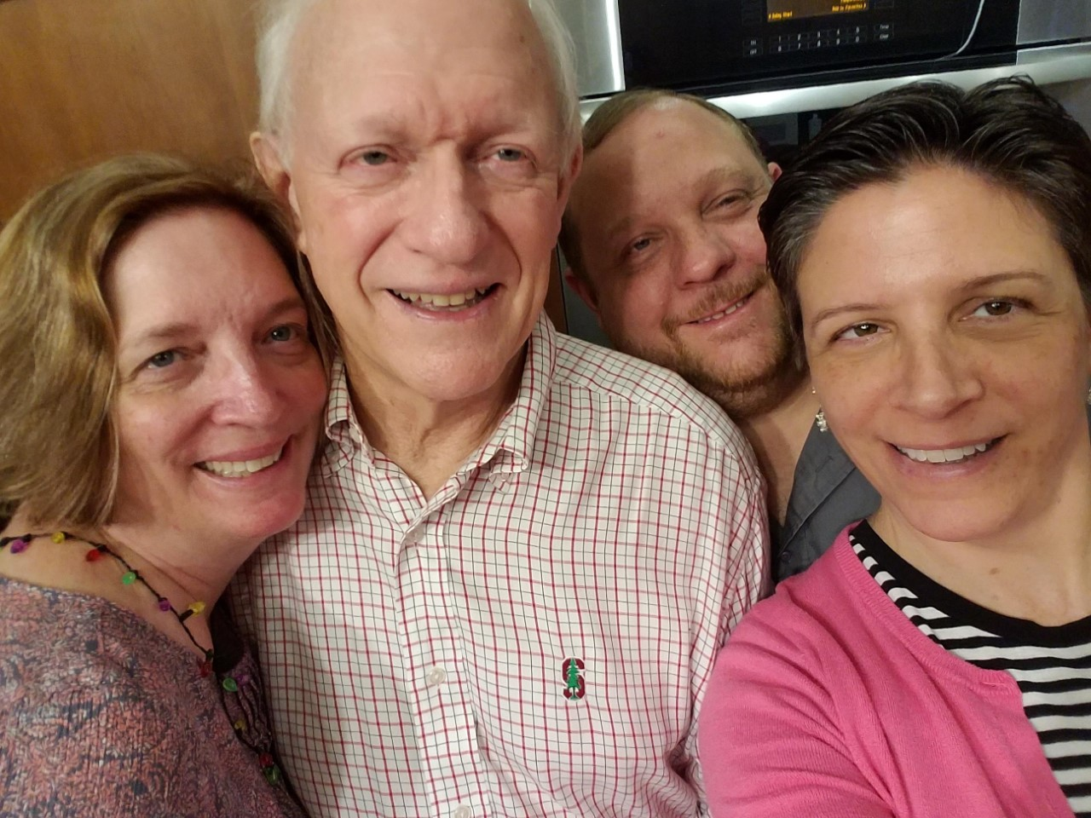
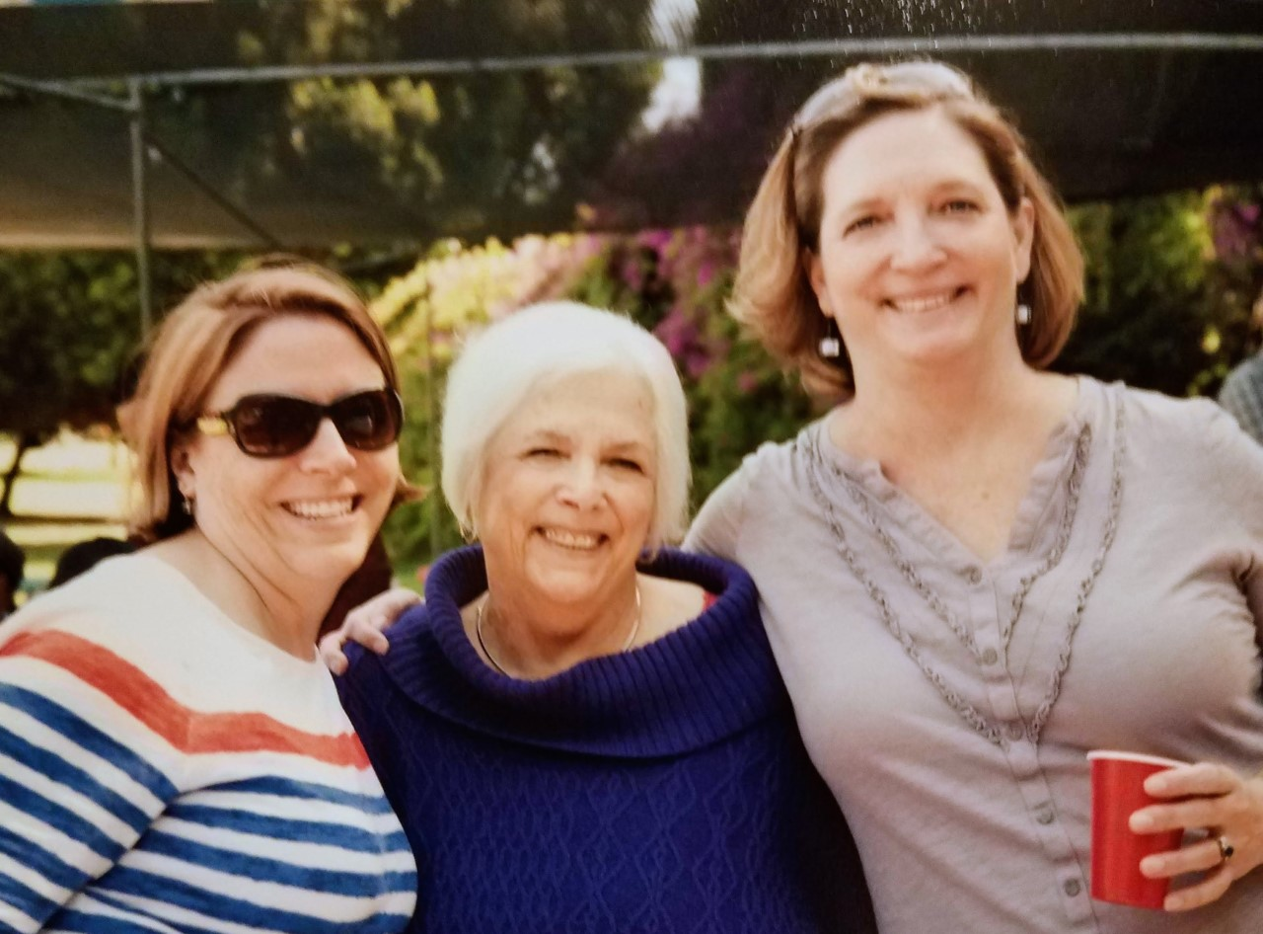
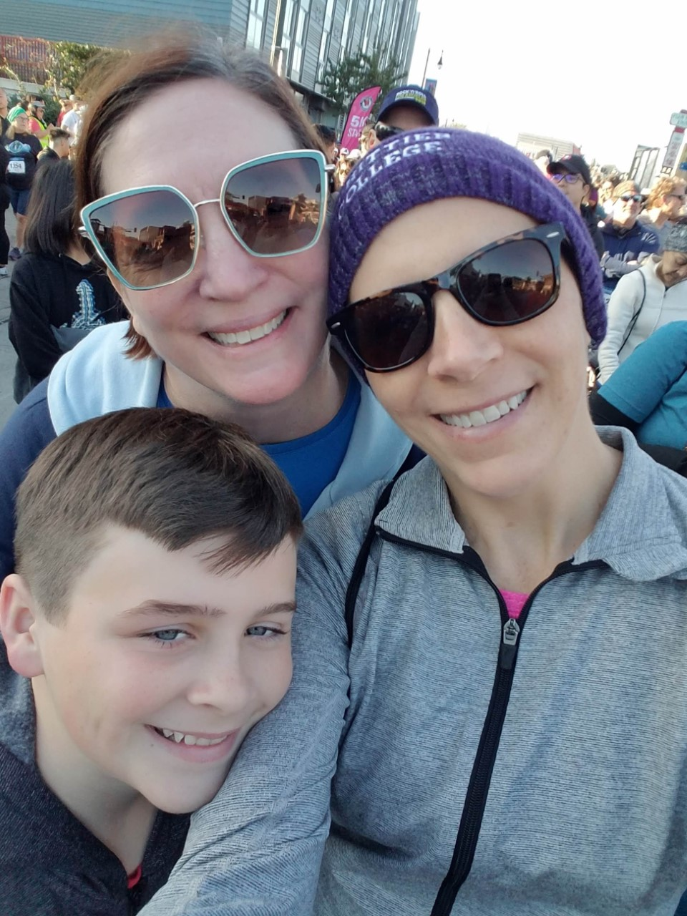
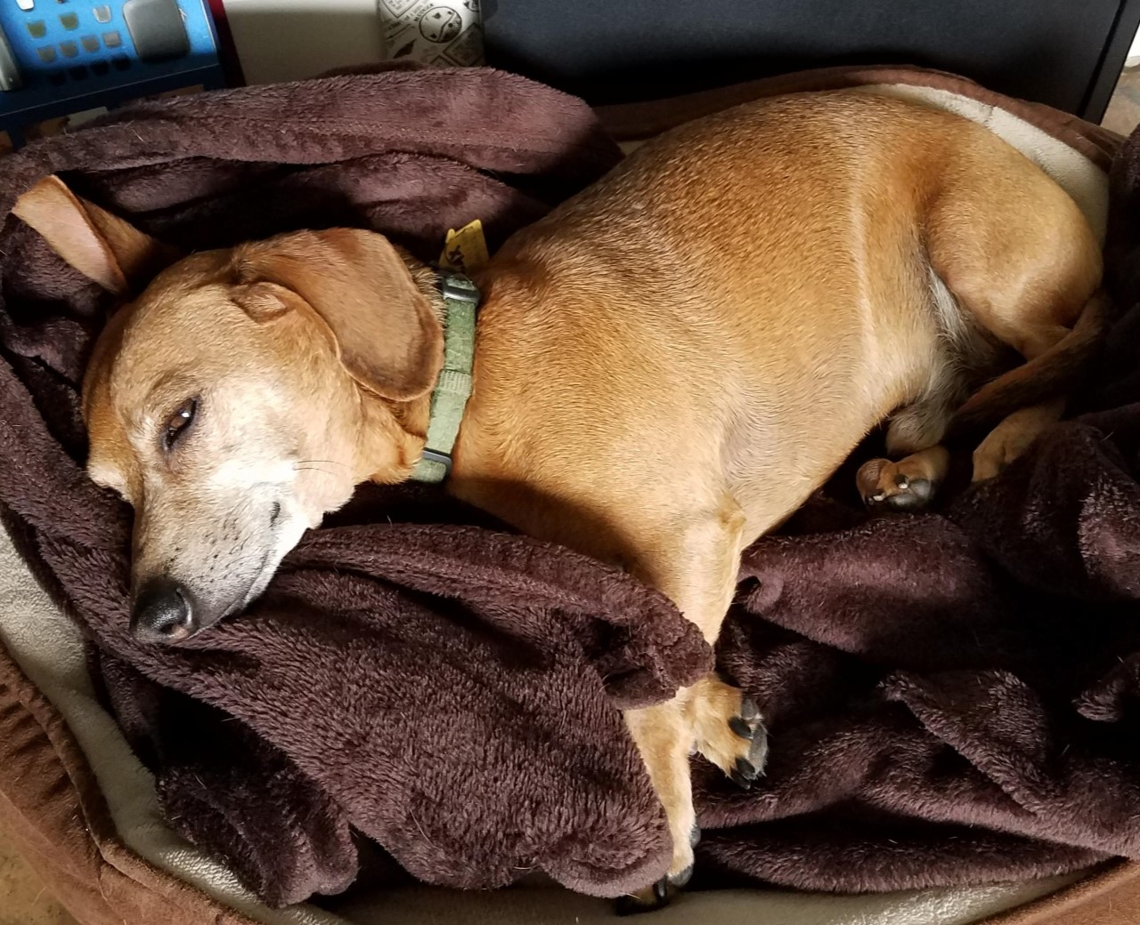
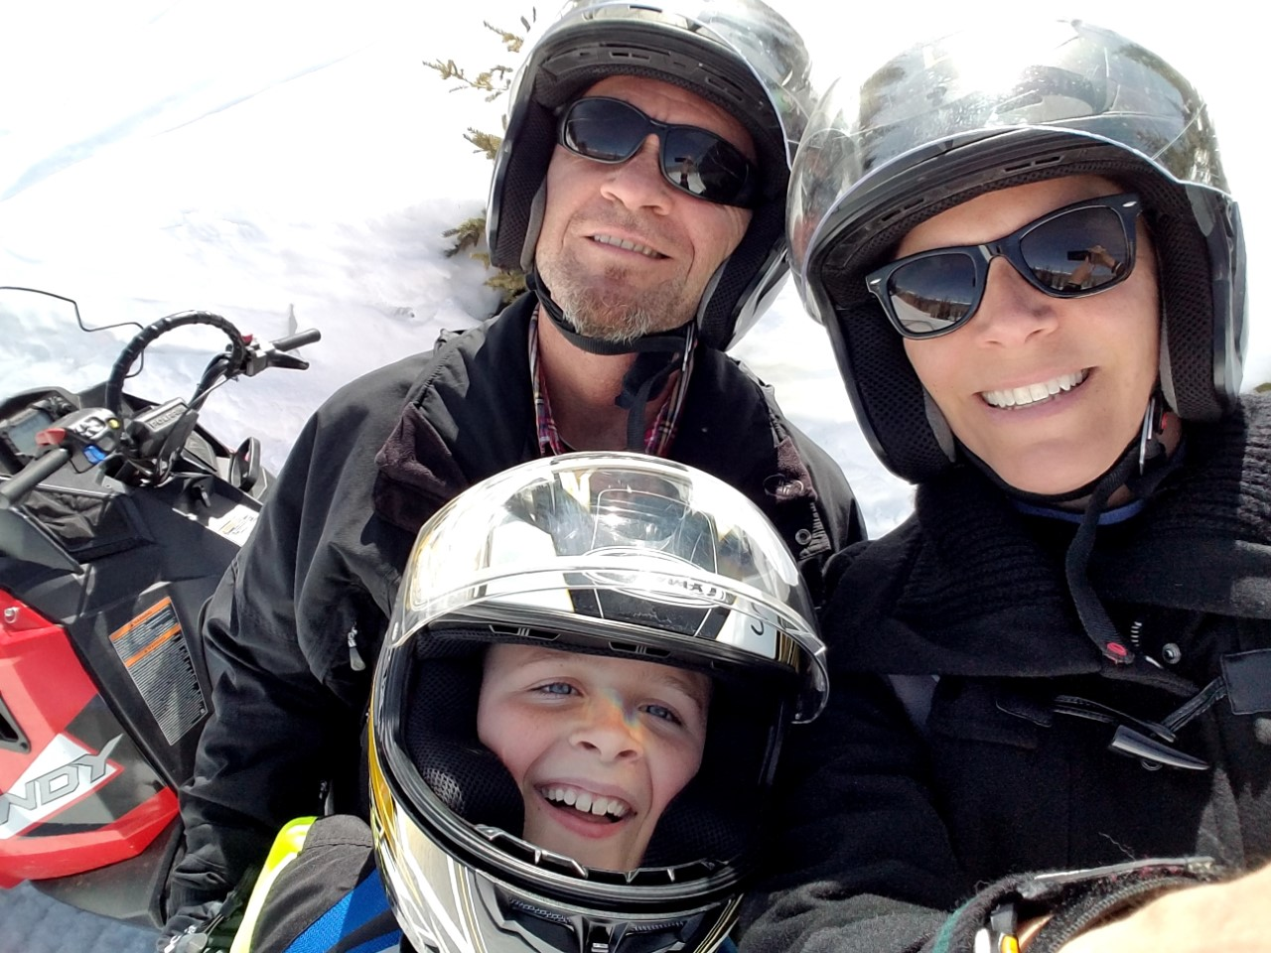
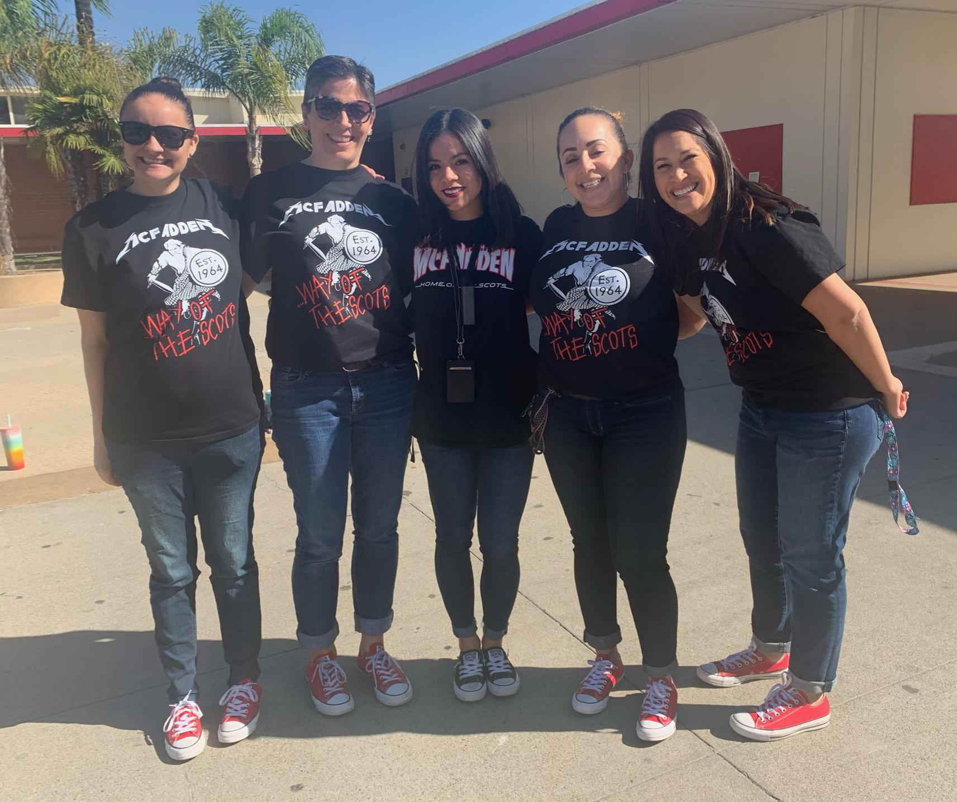
Getting to know me
Mrs. Jessica Fitzpatrick
I attended Boston University and Whittier College.
At Whittier I earned my BA in Technical Theatre and my teaching credentials and my MA in Education.
I have been teaching 13 years, four of those at McFadden!
Family, friends, and my job are my world. (Mostly family and friends!)
Notes:
Use this slide to introduce yourself and share a little bit about yourself

Slide 3
Class Expectations
Students, parents and teachers work together to master study skills, collaborative skills, and become lifelong learners.
Attendance
Be on time.
Be prepared with technology and materials.
Sign in daily to Google Classroom.
Participation
Stay focused.
Be an active participant.
Pay attention.
Presentation
Check your surroundings.
Dress appropriately.
Keep camera on.
No eating on camera.
Be responsible
Raise your hand and wait your turn to talk.
Mute your mic to avoid background noise.
Notes:
Type in your classroom expectations- make sure they are in line with our school expectations for distance learning.

Slide 4
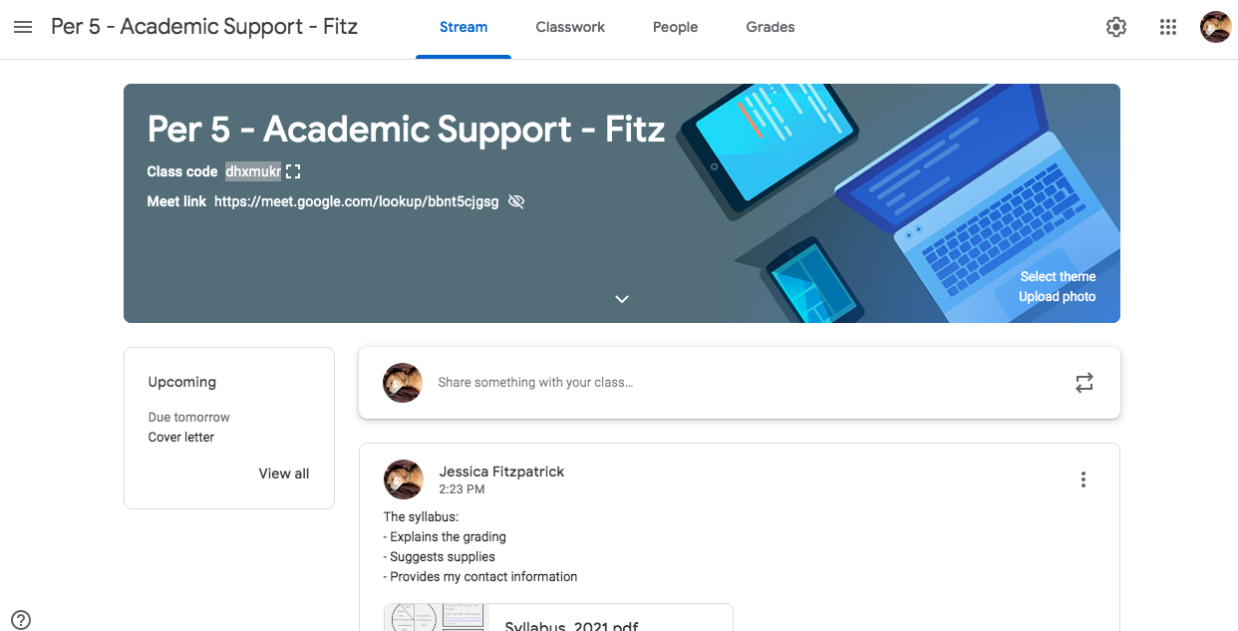
Current platform our class is using:
Google Classroom
Class code:
dhxmukr
Notes:
Discuss the platform you are using and any details pertaining that are critical for parents to know. (ie codes.) Maybe show an image of what it looks like for a student.

Slide 5
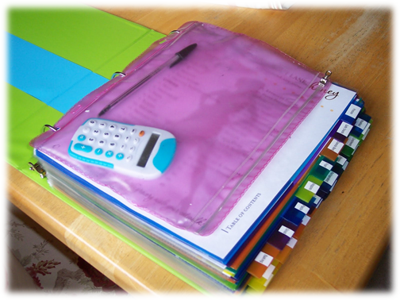
Homework and Classwork
Classwork includes, but is not limited to:
ALEKS
iLit
Achieve3000
Working on IEP goals
Grade checks (checking grades and work from other classes)
Homework includes, but is not limited to:
ALEKS (10 topics per week)
Finishing work not completed in class
Notes:
Explain your expectations for these two topics

Slide 6
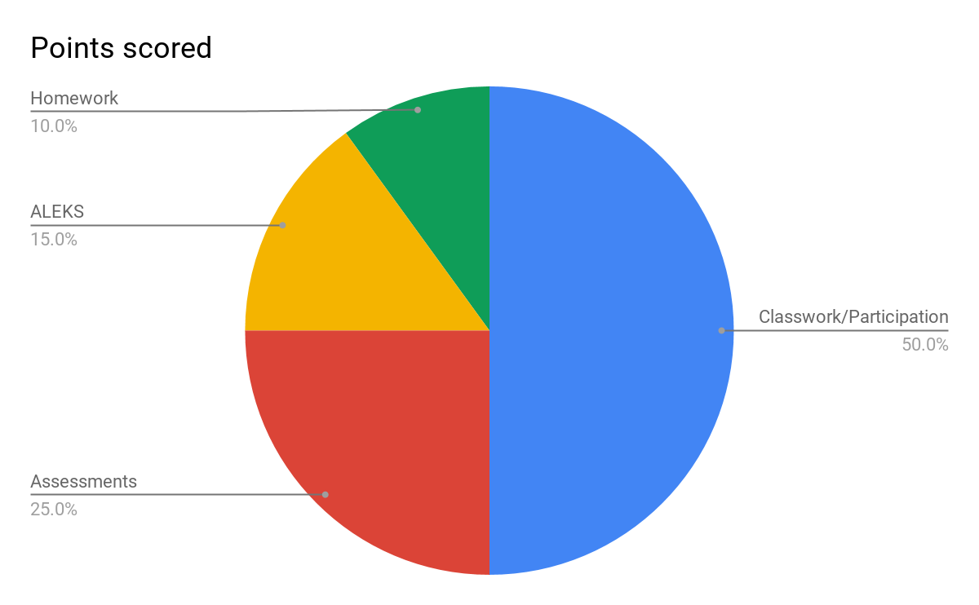
Grading Policy
Notes:
Discuss your grading policy so that parents know the expectations

Slide 7
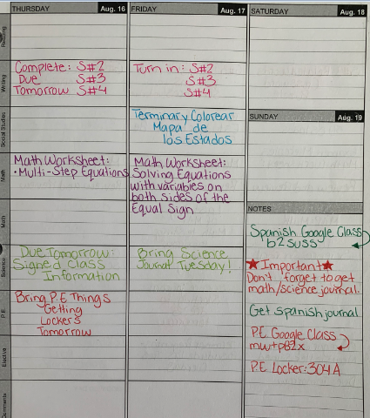
How parents can help at home:
Regularly check binders and backpacks to make sure your student is keeping up with organizational strategies on a daily basis (No loose paper, materials needed are present, assignments are in proper order).
Offer feedback for student so that binder “issues” can be remedied before checks.
Check school Agenda for: homework, due dates, tests, long-term assignments and add family events to the calendar to help students with time management of school work and fun activities.

Slide 8
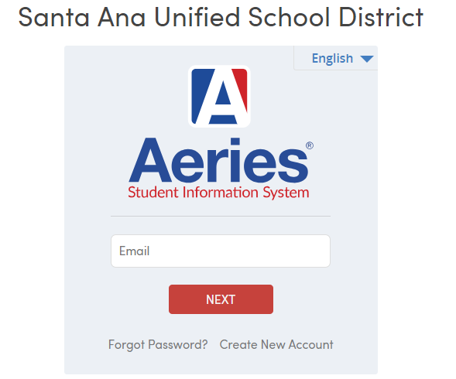
Aeries: Parent Portal
Connecting and communicating with parents is a primary goal at SAUSD. The portal provides details on items such as student attendance, grades, and test scores.
*1st grading period ends Friday, Sept 20th.
**Report card grades will be available on
Aeries Wednesday, Sept. 25th.
Example - student login
Email: 6 digit student ID @sausdlearns.net
Password: 8 digit birthday
Link to SAUSD parent portal

Slide 9
Office hours:
Monday, Tuesday, Thursday, Friday
1:40 PM - 2:34 PM
Wednesday
1:10 PM - 1:30 PM
How to get a hold of Mrs. Fitzpatrick:
ParentSquare
949-484-5220 – call or text
jessica.fitzpatrick@sausd.us
Notes:
Include information on how parents can get a hold of you. Email, parentsquare, instagram, etc…...

